Slide 1


MediLink – Medical Marketplace
FastAPI + MongoDB Based Healthcare Management System

Slide 2



Project Overview
Medilink Pro is a healthcare management system developed using FastAPI and MongoDB.
Provides APIs for Patients and Medicines management
Supports CRUD operations (Create, Read, Update, Delete)
Data stored in MongoDB and JSON for backup
- RESTful endpoints tested via Postman
PPT Medi Link Medical Market Place

Slide 3
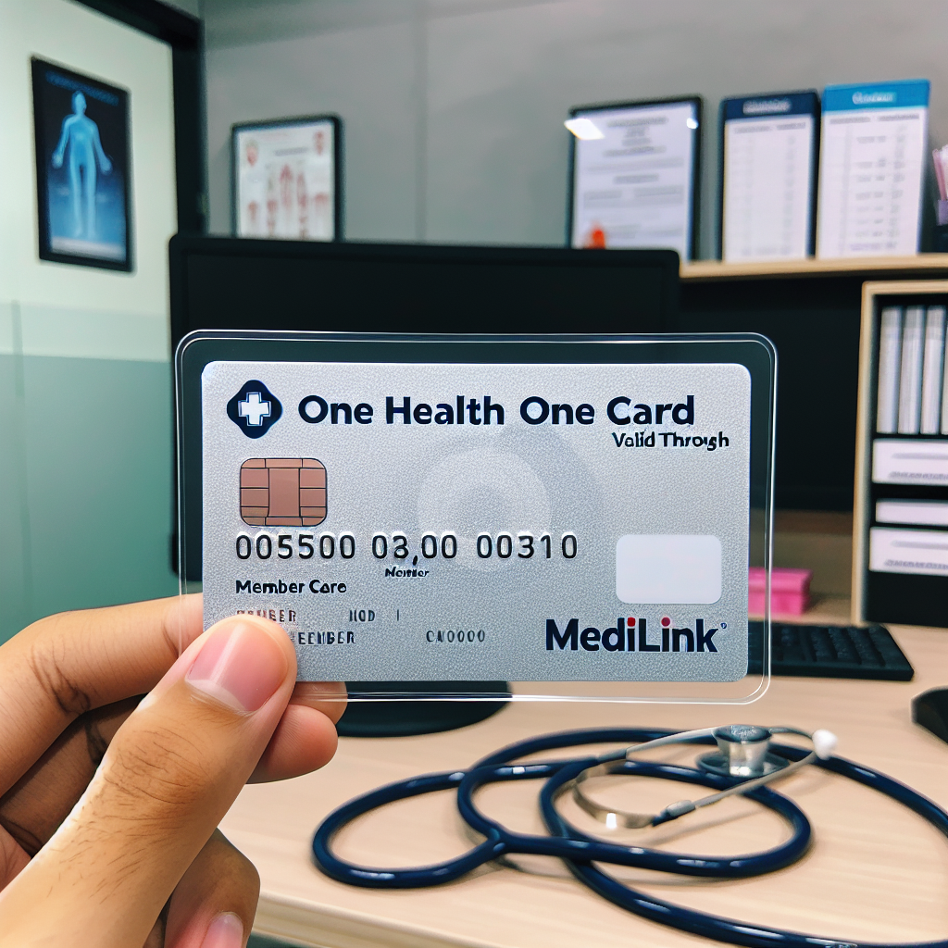
Objectives
• Build a modular, scalable healthcare management API
• Integrate MongoDB for real-time data persistence
• Enable JSON storage for backups
Provide clean and professional API endpoints
• Ensure ease of testing with Postman
PPT Medi Link Medical Market Place

Slide 4

Architecture
The project follows a layered architecture:
• FastAPI for REST API framework
• Motor (async MongoDB driver) for DB integration
• JSON Store for local storage
• Modular routers: Patients & Medicines
• Pydantic models for validation
PPT Medilink Medical Market Place

Slide 5
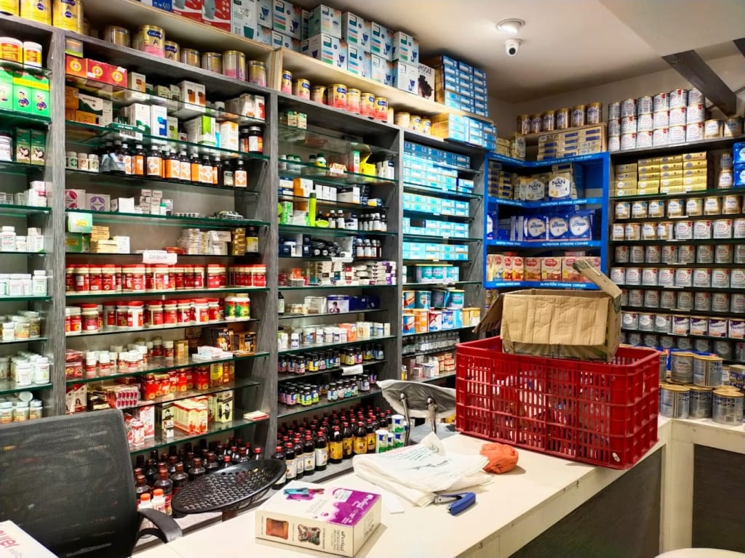
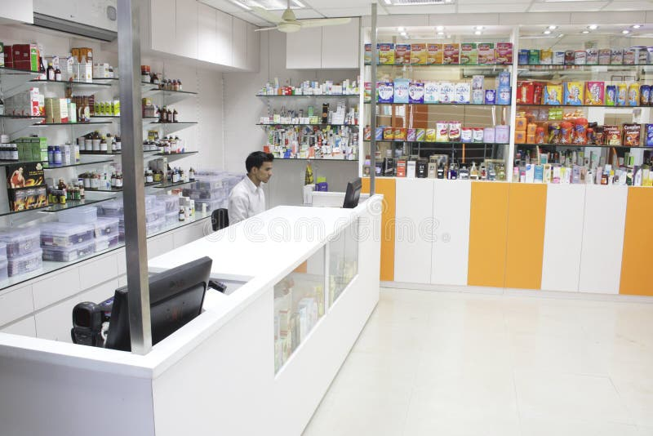
Tools And Technologies
API End Points
• FastAPI (Backend Framework)
• MongoDB (Database)
• Motor (Async MongoDB driver)
• Pydantic (Data validation)
• Postman (API Testing)
• Git & GitHub (Version Control)
• Python 3.11 (Programming Language)
Patients:
- POST /api/patients → Create patient
- GET /api/patients → Get all patients
- GET /api/patients/{id} → Get patient by ID
- PUT /api/patients/{id} → Update patient
- DELETE /api/patients/{id} → Delete patient
Medicines:
- POST /api/medicines → Create medicine
- GET /api/medicines → Get all medicines
- GET /api/medicines/{id} → Get medicine by ID
- PUT /api/medicines/{id} → Update medicine
- DELETE /api/medicines/{id} → Delete medicine
Conclusion
Medilink Pro successfully demonstrates a healthcare management system with:
- CRUD APIs for patients and medicines
- MongoDB + JSON data persistence
- Secure and scalable backend with FastAPI
- Professional API testing through Postman
This project can be extended with authentication, billing, and reporting features.
a
PPT Medilink Medical Market Place

Slide 6
Thank You

